Slide 1
Retail Analytics – Chips Category Review
March 2026
Trial Store Performance Analysis
Brand note: If client logo is not required, use alternate title page layout right click slide thumbnail > Layout > Title
Om Hole

Slide 2
Notes:
To view Privacy video explaining how important data privacy is to Quantium, please click here: https://www.youtube.com/watch?v=Zq1QDAkoRzU
or here Q:\Company Reference\Brand & Design\Brand videos\Q Privacy.mp4
At Quantium, we believe that data is the behavioural footprint of humanity and that it has to be treated with the utmost care and responsibility.
Histories, attitudes, indeed lives are stored within it in ways that aren’t always apparent – and that’s what makes its potential so powerful.
To work with it responsibly, sensitively, we set ourselves the highest data privacy protection and governance standards.
We have spent 17 years perfecting privacy-by-design and secure-by-design principles. Central to this is not holding any personally identifiable information about people –
we neither receive it, and put the necessary protections in place to be unable to decipher it.
Every aspect of handling data is safeguarded: from its de-identification, to its encryption – data security is paramount and of the highest grade.
We pride ourselves on gaining the trust of iconic organisations around the world through years of securely working with their data,
and in turn the trust that builds with their stakeholders.

Slide 3
Executive summary
01
Task 1 :
Key Insights
Chips category sales are driven primarily by specific customer segments
Higher contribution observed from:
Mainstream and Budget customers
Young Singles/Couples and Families
Premium customers contribute less to overall sales volume
Purchasing behaviour varies by life stage and affluence level
02
Task 2 :
Trial Store Analysis
Control stores were selected using correlation based on:
Sales
Number of customers
Transactions per customer
Trial stores did not show a consistent increase in sales compared to control stores
Observed differences were aligned with normal business fluctuations
No strong evidence that trial layouts improved store performance

Slide 4
01Customer Insights
Mainstream and Budget customers drive most chip sales
Young Singles/Couples and Families are key segments
Premium customers contribute less to total sales

Slide 5
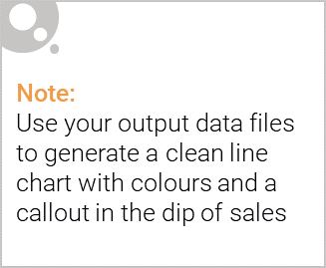
Category Overview
Chips category is highly influenced by customer segments
Budget and Mainstream dominate
Families and young consumers drive volume

Slide 6
02 Control Store Selection
Control stores selected using correlation across:
Sales
Customers
Transactions per customer
Example: Store 77 matched with Store 3

Slide 7
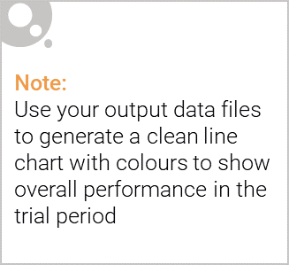

Slide 8
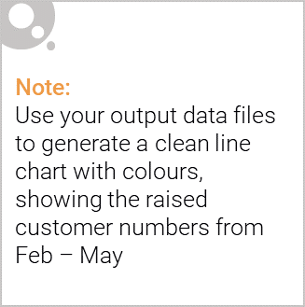
Key Insights
Trial stores did not outperform control stores
No consistent uplift across all locations
Correlation alone is not sufficient for store comparison
Performance differences reflect normal business variation

Slide 9
Recommendations
Do not roll out new layout at this stage
Conduct further testing
Use better-matched control stores
Extend trial duration

Slide 10
Thank You

